Slide 1
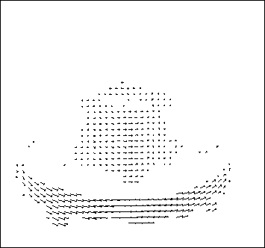
Motion and optical flow
Thursday, Nov 20
Many slides adapted from S. Seitz, R. Szeliski, M. Pollefeys, S. Lazebnik

Slide 2
Today
Pset 3 solutions
Introduction to motion
Motion fields
Feature-based motion estimation
Optical flow

Slide 3
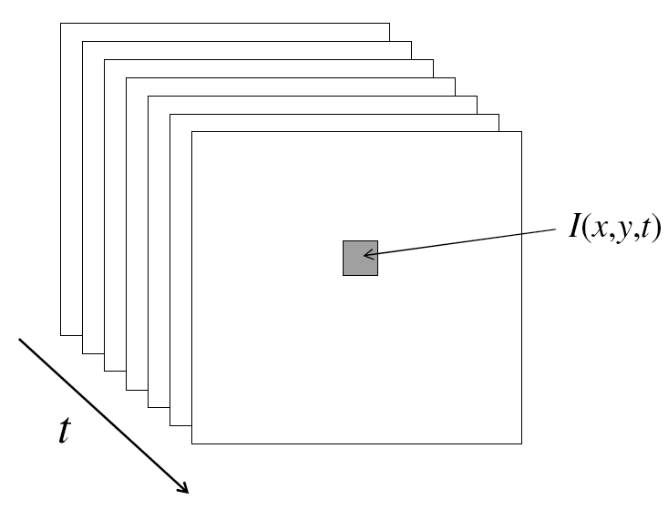
Video
A video is a sequence of frames captured over time
Now our image data is a function of space
(x, y) and time (t)

Slide 4
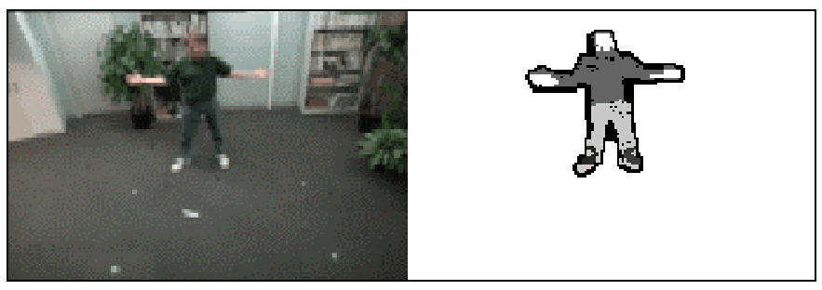
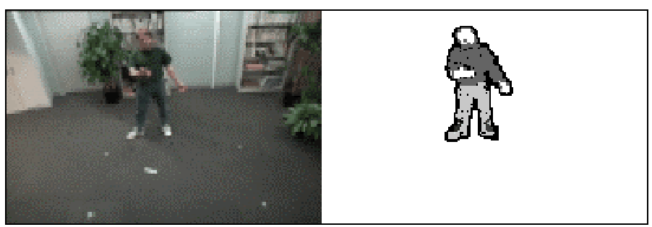
Applications of segmentation to video
Background subtraction
  A static camera is observing a scene
  Goal: separate the static background from the moving foreground
How to come up with background frame estimate without access to “empty” scene?

Slide 5
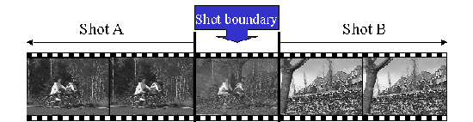
Applications of segmentation to video
Background subtraction
Shot boundary detection
  Commercial video is usually composed of shots or sequences showing the same objects or scene
  Goal: segment video into shots for summarization and browsing (each shot can be represented by a single keyframe in a user interface)
  Difference from background subtraction: the camera is not necessarily stationary

Slide 6
Applications of segmentation to video
Background subtraction
Shot boundary detection
  For each frame
    Compute the distance between the current frame and the previous one
      Pixel-by-pixel differences
      Differences of color histograms
      Block comparison
    If the distance is greater than some threshold, classify the frame as a shot boundary

Slide 7
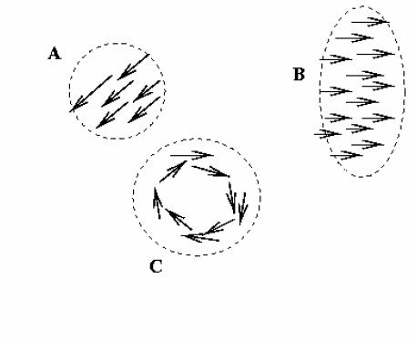
Applications of segmentation to video
Background subtraction
Shot boundary detection
Motion segmentation
  Segment the video into multiple coherently moving objects

Slide 8
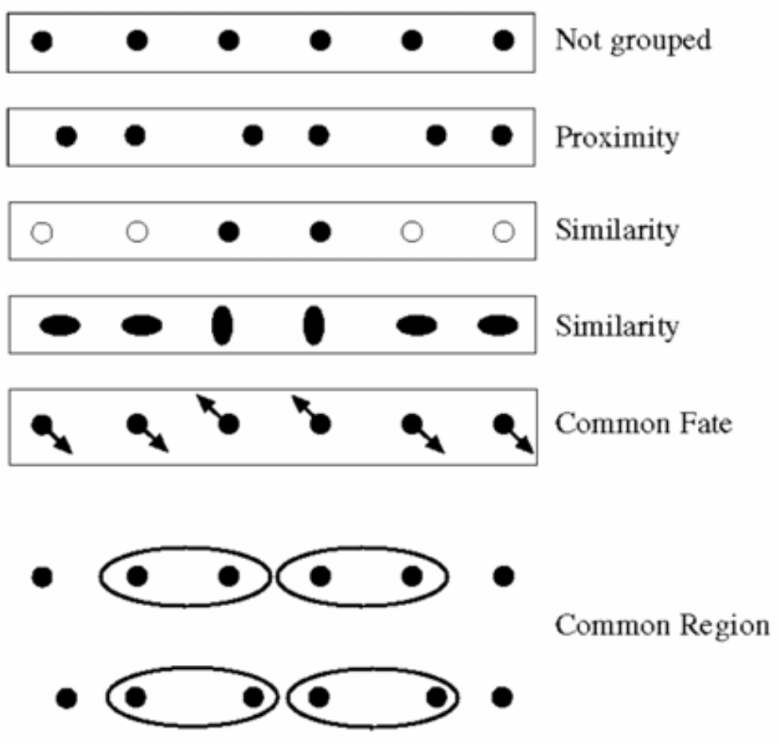
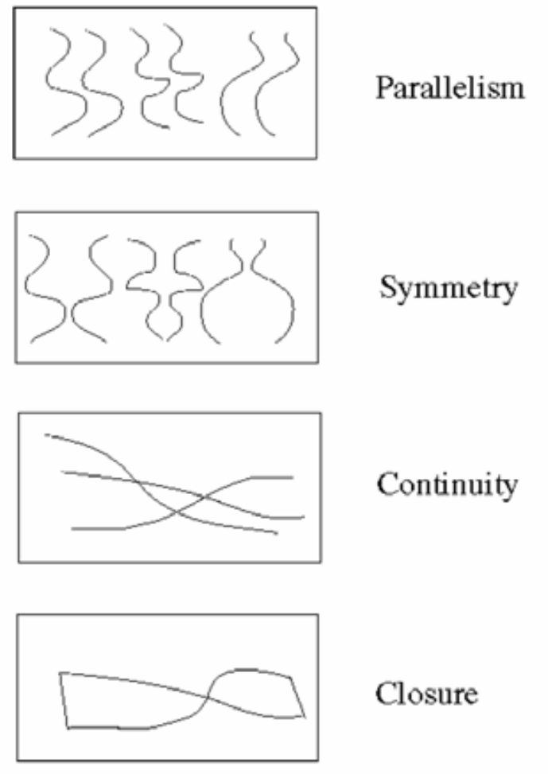
Motion and perceptual organization
Sometimes, motion is the only cue

Slide 9
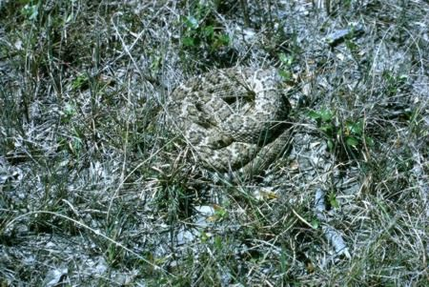
Motion and perceptual organization
Sometimes, motion is foremost cue

Slide 10
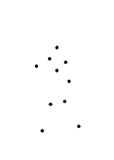
Motion and perceptual organization
Even “impoverished” motion data can evoke a strong percept

Slide 11
Motion and perceptual organization
Even “impoverished” motion data can evoke a strong percept

Slide 12
Uses of motion
Estimating 3D structure
Segmenting objects based on motion cues
Learning dynamical models
Recognizing events and activities
Improving video quality (motion stabilization)

Slide 13
Today
Pset 3 solutions
Introduction to motion
Motion fields
Feature-based motion estimation
Optical flow

Slide 14
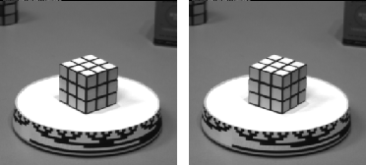
Motion field
The motion field is the projection of the 3D scene motion into the image

Slide 15
Motion field and parallax
P(t) is a moving 3D point
Velocity of scene point: V = dP/dt
p(t) = (x(t),y(t)) is the projection of P in the image
Apparent velocity v in the image: given by components v_{x} = dx/dt and v_{y} = dy/dt
These components are known as the motion field of the image
P(t+dt)
P(t)
V
v
p(t+dt)
p(t)

Slide 16
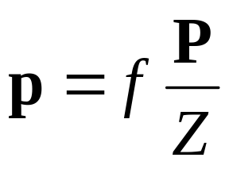
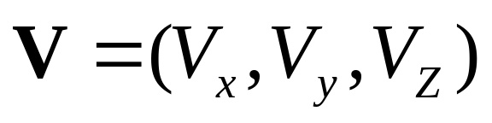
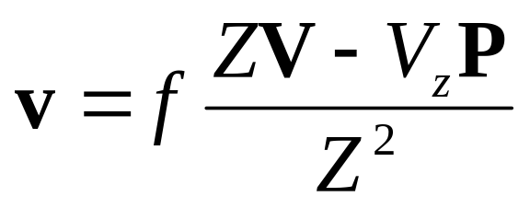
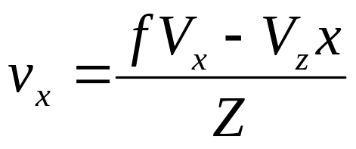
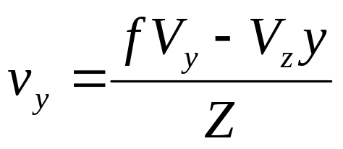
Motion field and parallax
Quotient rule:
D(f/g) = (g f’ – g’ f)/g^2
P(t+dt)
P(t)
V
To find image velocity v, differentiate
p with respect to t (using quotient rule):
v
p(t+dt)
p(t)
Image motion is a function of both the 3D motion (V) and the
depth of the 3D point (Z)

Slide 17

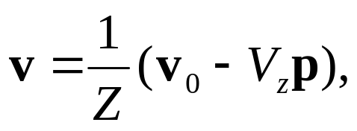

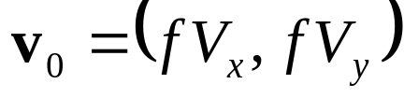
Motion field and parallax
Pure translation: V is constant everywhere

Slide 18
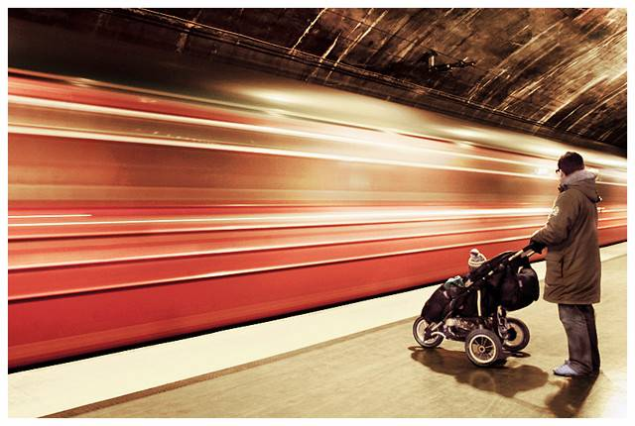
Motion field and parallax
Pure translation: V is constant everywhere
V_{z} is nonzero:
  Every motion vector points toward (or away from) v₀,
  the vanishing point of the translation direction

Slide 19
Motion field and parallax
Pure translation: V is constant everywhere
V_{z} is nonzero:
  Every motion vector points toward (or away from) v₀,
  the vanishing point of the translation direction
V_{z} is zero:
  Motion is parallel to the image plane, all the motion vectors are parallel
The length of the motion vectors is inversely proportional to the depth Z

Slide 20
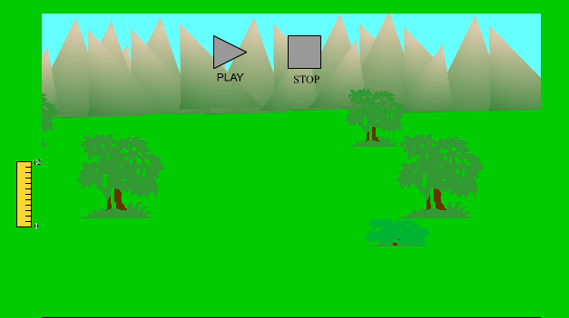
Motion parallax
http://psych.hanover.edu/KRANTZ/MotionParallax/MotionParallax.html

Slide 21
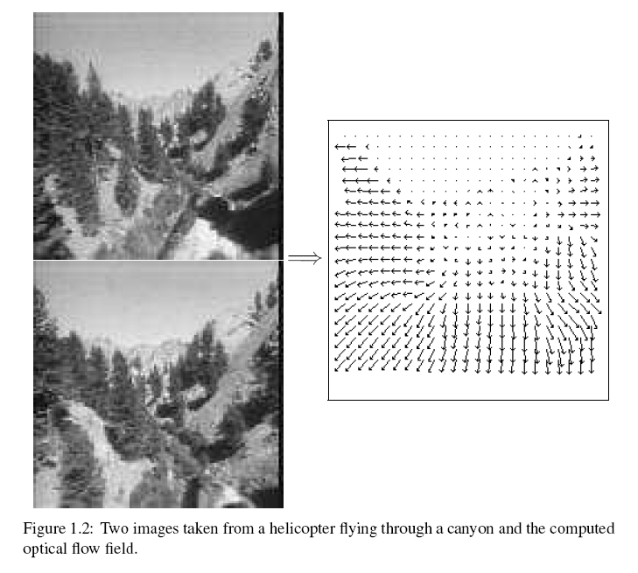
Motion field + camera motion
Length of flow vectors inversely proportional to depth Z of 3d point
points closer to the camera move more quickly across the image plane
Figure from Michael Black, Ph.D. Thesis

Slide 22
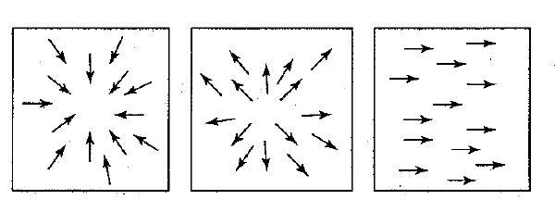
Motion field + camera motion
Zoom out
Zoom in
Pan right to left

Slide 23
Motion estimation techniques
Feature-based methods
  Extract visual features (corners, textured areas) and track them over multiple frames
  Sparse motion fields, but more robust tracking
  Suitable when image motion is large (10s of pixels)
Direct methods
  Directly recover image motion at each pixel from spatio-temporal image brightness variations
  Dense motion fields, but sensitive to appearance variations
  Suitable for video and when image motion is small

Slide 24
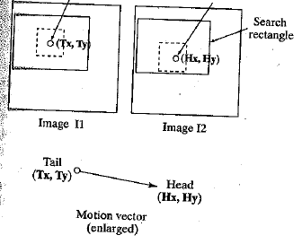
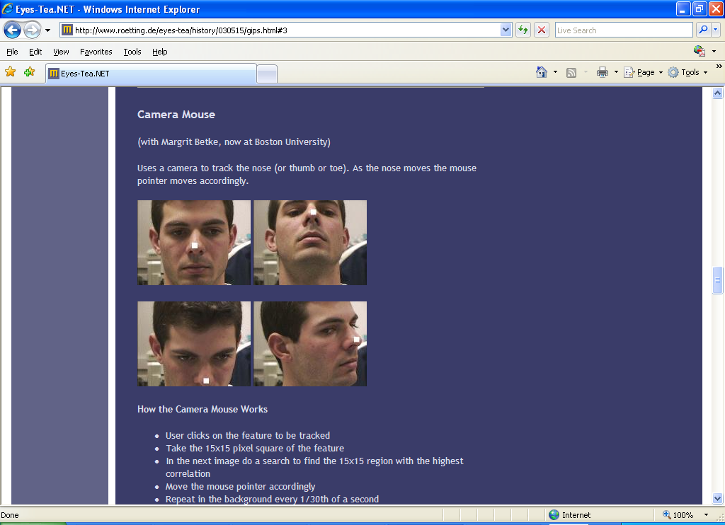
Feature-based matching for motion
Best matching neighborhood
Interesting point
Time t
Time t+1

Slide 25
A Camera Mouse
Video interface: use feature tracking as mouse replacement
User clicks on the feature to be tracked
Take the 15x15 pixel square of the feature
In the next image do a search to find the 15x15 region with the highest correlation
Move the mouse pointer accordingly
Repeat in the background every 1/30th of a second
James Gips and Margrit Betke
http://www.bc.edu/schools/csom/eagleeyes/

Slide 26
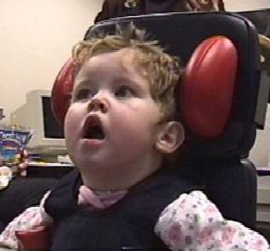
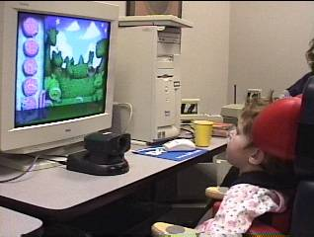
A Camera Mouse
Specialized software for communication, games
James Gips and Margrit Betke
http://www.bc.edu/schools/csom/eagleeyes/

Slide 27
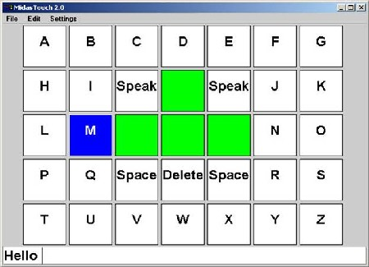
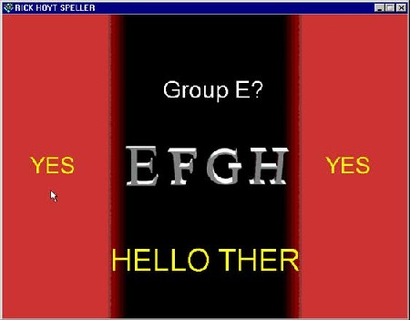
A Camera Mouse
Specialized software for communication, games
James Gips and Margrit Betke
http://www.bc.edu/schools/csom/eagleeyes/

Slide 28
What are good features to track?
Recall the Harris corner detector
Can measure quality of features from just a single image
Automatically select candidate “templates”

Slide 29
Motion estimation techniques
Feature-based methods
  Extract visual features (corners, textured areas) and track them over multiple frames
  Sparse motion fields, but more robust tracking
  Suitable when image motion is large (10s of pixels)
Direct methods
  Directly recover image motion at each pixel from spatio-temporal image brightness variations
  Dense motion fields, but sensitive to appearance variations
  Suitable for video and when image motion is small

Slide 30
Optical flow
Definition: optical flow is the apparent motion of brightness patterns in the image
Ideally, optical flow would be the same as the motion field
Have to be careful: apparent motion can be caused by lighting changes without any actual motion

Slide 31

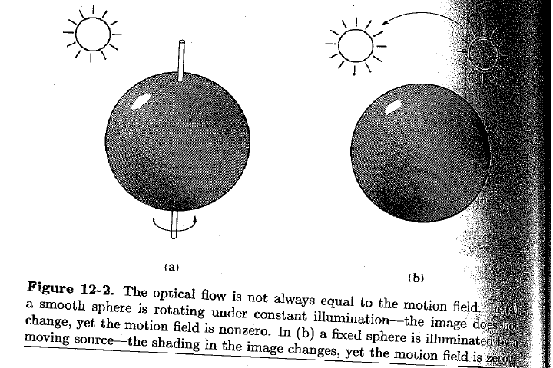
Apparent motion ~= motion field
Figure from Horn book

Slide 32
Estimating optical flow
I(x,y,t–1)
I(x,y,t)
Given two subsequent frames, estimate the apparent motion field between them.
Key assumptions
  Brightness constancy: projection of the same point looks the same in every frame
  Small motion: points do not move very far
  Spatial coherence: points move like their neighbors

Slide 33
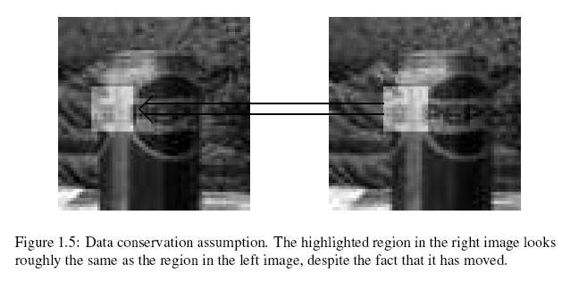
Brightness constancy
Figure by Michael Black

Slide 34



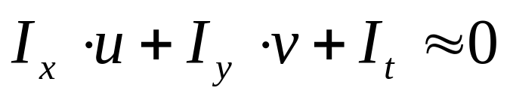
The brightness constancy constraint
I(x,y,t–1)
I(x,y,t)
Brightness Constancy Equation:
Can be written as:
So,

Slide 35
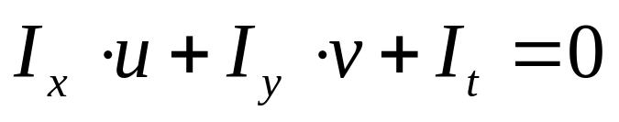
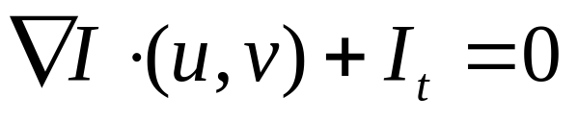
The brightness constancy constraint
How many equations and unknowns per pixel?
  One equation, two unknowns
Intuitively, what does this constraint mean?
The component of the flow perpendicular to the gradient (i.e., parallel to the edge) is unknown

Slide 36

The brightness constancy constraint
How many equations and unknowns per pixel?
  One equation, two unknowns
Intuitively, what does this constraint mean?
The component of the flow perpendicular to the gradient (i.e., parallel to the edge) is unknown
gradient
(u,v)
  If (u, v) satisfies the equation,
  so does (u+u’, v+v’) if
(u’,v’)
(u+u’,v+v’)
edge

Slide 37
The aperture problem
Perceived motion

Slide 38
The aperture problem
Actual motion

Slide 39

The barber pole illusion
http://en.wikipedia.org/wiki/Barberpole_illusion

Slide 40

The barber pole illusion
http://en.wikipedia.org/wiki/Barberpole_illusion

Slide 41

The barber pole illusion
http://en.wikipedia.org/wiki/Barberpole_illusion

Slide 42
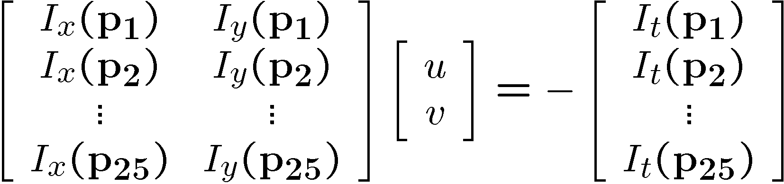




Solving the aperture problem (grayscale image)
How to get more equations for a pixel?
Spatial coherence constraint: pretend the pixel’s neighbors have the same (u,v)
  If we use a 5x5 window, that gives us 25 equations per pixel

Slide 43






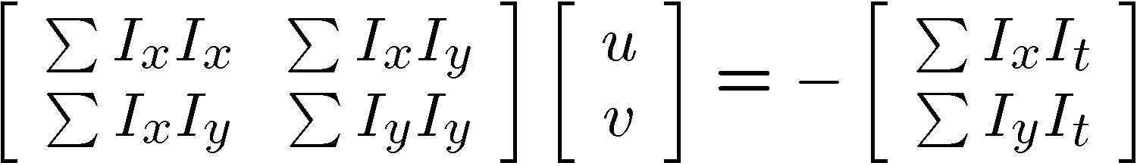


Solving the aperture problem
Prob: we have more equations than unknowns
Solution: solve least squares problem
  minimum least squares solution given by solution (in d) of:
  The summations are over all pixels in the K x K window
  This technique was first proposed by Lucas & Kanade (1981)

Slide 44
Conditions for solvability
When is this solvable?
  A^{T}A should be invertible
  A^{T}A should not be too small
    eigenvalues λ₁ and λ₂ of A^{T}A should not be too small
  A^{T}A should be well-conditioned
    λ₁/ λ₂ should not be too large (λ₁ = larger eigenvalue)
Slide by Steve Seitz, UW

Slide 45
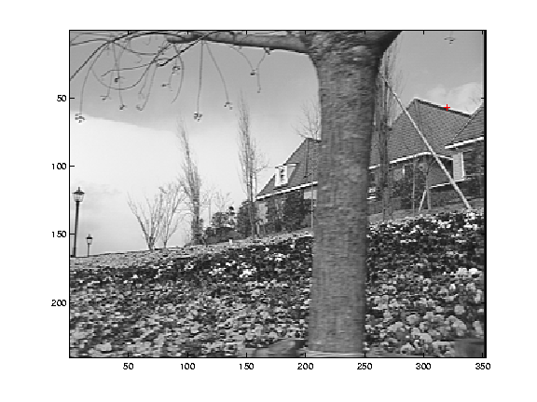
Edge
gradients very large or very small
large λ₁, small λ₂

Slide 46
Low-texture region
gradients have small magnitude
small λ₁, small λ₂

Slide 47
High-texture region
gradients are different, large magnitudes
large λ₁, large λ₂

Slide 48
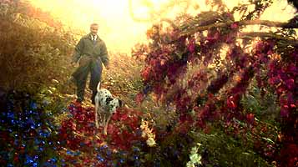
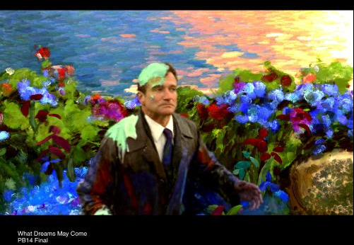
Example use of optical flow:
Motion Paint
Use optical flow to track brush strokes, in order to animate them to follow underlying scene motion.
http://www.fxguide.com/article333.html

Slide 49
Motion vs. Stereo: Similarities
Both involve solving
  Correspondence: disparities, motion vectors
  Reconstruction

Slide 50
Motion vs. Stereo: Differences
Motion:
  Uses velocity: consecutive frames must be close to get good approximate time derivative
  3d movement between camera and scene not necessarily single 3d rigid transformation
Whereas with stereo:
  Could have any disparity value
  View pair separated by a single 3d transformation

Slide 51
Summary
Motion field: 3d motions projected to 2d images; dependency on depth
Solving for motion with
  sparse feature matches
  dense optical flow
Optical flow
  Brightness constancy assumption
  Aperture problem
  Solution with spatial coherence assumption

